Slide 1
Numerical Linear Algebra meets Machine Learning
Fabian Koffer, Simon Hanselmann, Yannick Funk,
Dennis Leon Grötzinger, Anna Ricker

Slide 2
What was implemented?
What was implemented
Which optional requirements were dropped

Slide 3
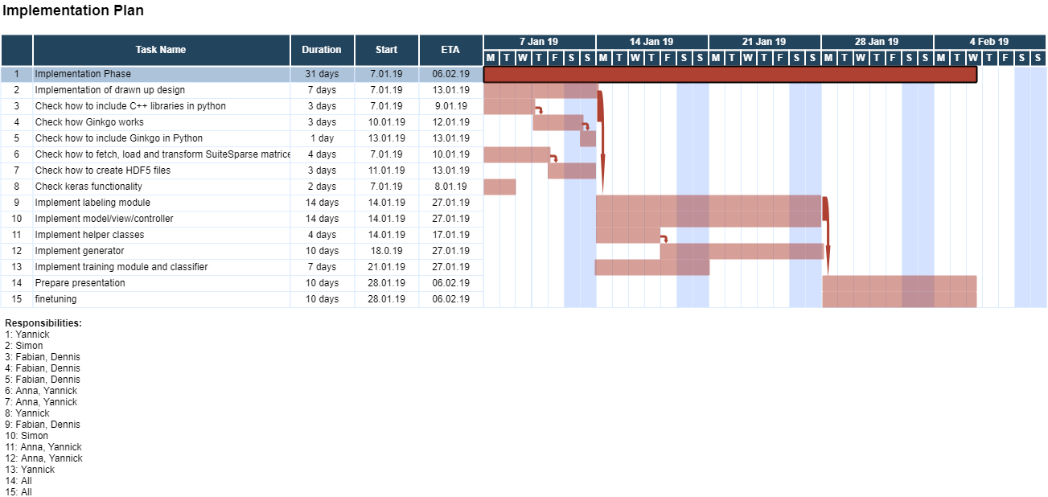
Time schedule

Slide 4
Delays

Slide 5
Problems

Slide 6
Changes of the design

Slide 7
Statistics
Lines of code:
Commits:
Work splitting

Slide 8
Development model
Communication in the team
How was GIT used? Was the merging on the master restricted?

